Slide 1

Driver drowsiness detection system using deep learning methods
Student Name:
Student Id:
Supervisor Name:

Slide 2
Introduction
Drowsy driving is a significant contributor to road accidents worldwide, posing serious safety risks.
Traditional detection methods rely on physical sensors, which are often costly, intrusive, and impractical for real-world use.
Recent advancements in artificial intelligence have enabled non-intrusive monitoring techniques.
This project utilizes deep learning and computer vision to detect driver drowsiness through facial features such as eye closure and head movement.
The proposed approach aims to provide a more efficient, accurate, and real-time solution for enhancing road safety.

Slide 3
Problem Statement
Drowsy driving is a major cause of road accidents, yet accurately identifying a driver’s level of drowsiness remains challenging. Existing methods often fail to reliably distinguish between different states such as alertness, yawning, and early signs of sleep due to subtle visual differences. Additionally, variations in real-world conditions and imbalanced data further complicate accurate detection, making it difficult to ensure timely and reliable classification of driver states.

Slide 4
Objectives
To develop a multi-class classification model for detecting different driver drowsiness states
To address class imbalance in the dataset to improve model performance
To apply data augmentation techniques for enhancing model generalization
To implement and compare different Convolutional Neural Network (CNN) models

Slide 5
Literature Review
Traditional driver drowsiness detection systems rely on sensors such as EEG, heart rate monitors, and vehicle behaviour analysis, which are often intrusive and impractical for real-world deployment (Dinges and Mallis, 1998)
Recent research has shifted towards computer vision-based deep learning approaches for non-intrusive monitoring of driver fatigue (Sikander and Anwar, 2019)
Convolutional Neural Networks (CNNs) have shown strong capability in extracting facial features such as eye closure and yawning for classification tasks (LeCun et al., 2015)
Pre-trained deep learning models such as VGG16, ResNet50, and MobileNetV2 are widely used with transfer learning to improve performance (Simonyan and Zisserman, 2014; He et al., 2016; Howard et al., 2017)
Despite advancements, challenges such as real-time processing, class imbalance, and environmental variations still affect system reliability (Dunn et al., 2020)

Slide 6
Identified Research Gaps
Existing sensor-based drowsiness detection systems are often intrusive, expensive, and not suitable for real-world continuous monitoring
Many deep learning models suffer from poor generalization due to limited and imbalanced datasets
Most existing systems struggle with real-time detection constraints, making them less effective for on-road deployment
Visual similarity between drowsiness states (e.g., blinking vs. sleepy vs. yawning) leads to misclassification and reduced accuracy

Slide 7
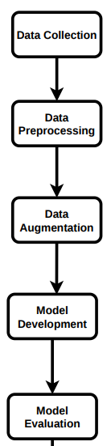
Proposed Methodology
Dataset Collection: Acquire driver facial image dataset
Preprocessing: Resize images, normalize data, and clean inputs
Data Augmentation: Apply transformations (rotation, flipping, zoom) to improve generalization
Model Development: Train multiple CNN models for multi-class classification
Evaluation: Assess model performance using metrics such as accuracy and loss

Slide 8
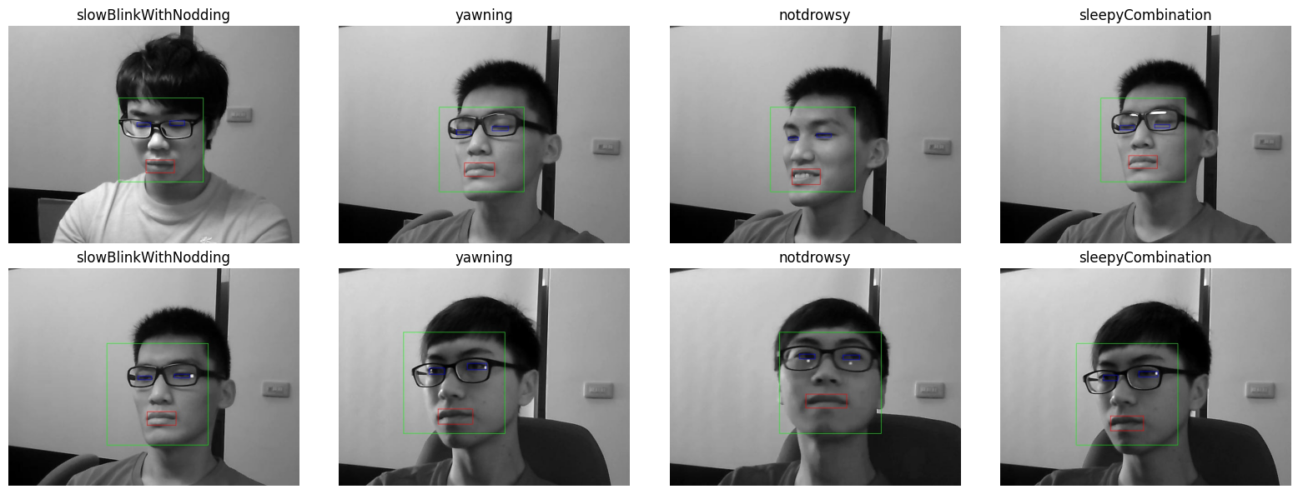
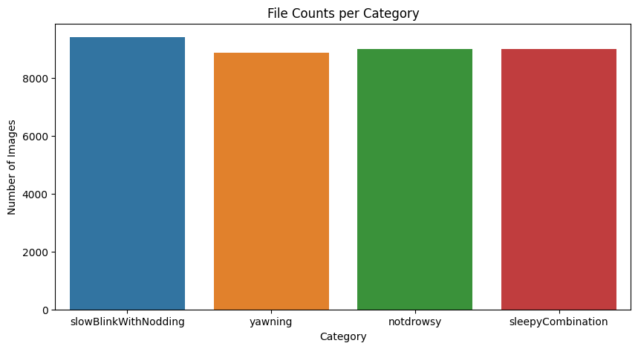
Dataset Description
Dataset Used: NTHU Driver Drowsiness Detection Dataset
Total Images: 66,521
Balanced Subset: 36,274 images used for training
Image Resolution: 128 × 128 pixels
Number of Classes: 4 (Not Drowsy, Yawning, Sleepy, Slow Blink & Nodding)
Dataset Link -https://www.kaggle.com/datasets/samymesbah/nthu-dataset-ddd-multi-class

Slide 9
Data Pre-Processing
The dataset is downloaded using the Kaggle API in the Google Colab environment to ensure easy access and reproducibility
After downloading, the dataset is extracted and organized into a structured directory format
Unnecessary nested or duplicate folders are removed to avoid confusion during model training
The dataset is cleaned by merging similar subcategories of drowsiness into four main classes
Class balancing is performed by reducing excess images from overrepresented classes to avoid model bias
The dataset is then split into training (70%), validation (15%), and testing (15%) sets for proper model evaluation
Data augmentation techniques such as rotation, flipping, zooming, and shifting are applied to increase dataset diversity and reduce overfitting
Finally, all images are normalized by scaling pixel values between 0 and 1 to improve training stability and convergence

Slide 10
Model Building
Model | Architecture Type | Key Layers / Structure | Transfer Learning Strategy | Parameter Tuning / Fine-Tuning | Optimizer & Loss | Learning Rate | Regularization | Remarks
Custom CNN | Deep CNN (from scratch) | Conv2D × (3–5), MaxPooling, Flatten, Dense (128–256), Dropout, Softmax | Not used | Kernel size tuning (3×3), filter scaling, batch size tuning, epoch tuning | Adam + Categorical Cross-Entropy | 1e-3 | Dropout (0.3–0.5), Early Stopping | Baseline model for feature learning (eyes, yawning, facial cues)
MobileNetV2 | Lightweight CNN | Base + Global Average Pooling + Dense (ReLU) + Softmax | Pretrained ImageNet | Frozen base → unfreeze last 30 layers | Adam + Categorical Cross-Entropy | 1e-4 → 1e-5 (fine-tuning) | Dropout + Weight decay | Optimized for real-time inference
VGG16 | Deep CNN (Uniform stack) | Conv blocks (3×3), MaxPooling ×5, Flatten, Dense (256), Dropout, Softmax | Pretrained ImageNet | Fully frozen base, classifier-only tuning | Adam + Categorical Cross-Entropy | 1e-4 | Dropout (0.5) | High parameter count, slow training
ResNet50 | Residual CNN | Residual blocks + Skip Connections + GAP + Dense + Softmax | Pretrained ImageNet | Partial fine-tuning (last layers) | Adam + Categorical Cross-Entropy | 1e-4 | Batch Normalization + Dropout | Stable gradients, slower convergence
DenseNet201 | Dense Connectivity CNN | Dense blocks + Transition layers + GAP + Dense (512) + Softmax | Pretrained ImageNet | Frozen base + classifier head tuning | Adam + Categorical Cross-Entropy | 1e-4 | Dropout (0.5) | Strong feature reuse, better gradient flow

Slide 11
Results
Model | Accuracy | Precision | Recall | F1-Score
Custom CNN | 0.8053 | 0.8171 | 0.8053 | 0.8024
MobileNetV2 | 0.6298 | 0.7045 | 0.6298 | 0.5944
DenseNet201 | 0.6719 | 0.7161 | 0.6719 | 0.6496
VGG16 | 0.4582 | 0.5915 | 0.4582 | 0.4308
ResNet50 | 0.2681 | 0.1476 | 0.2681 | 0.1507

Slide 12
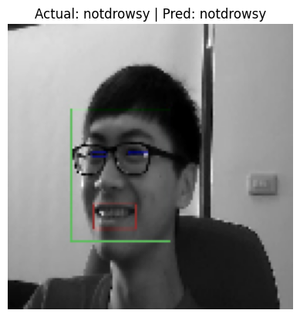
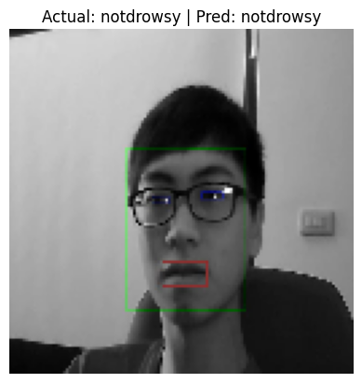
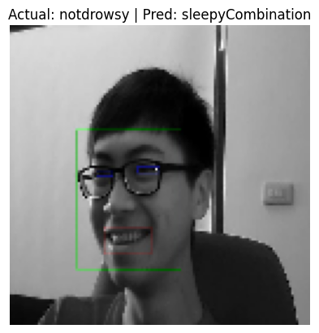
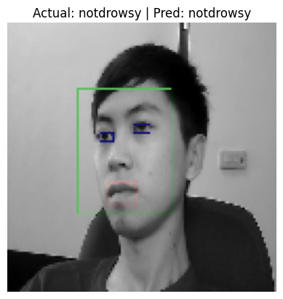
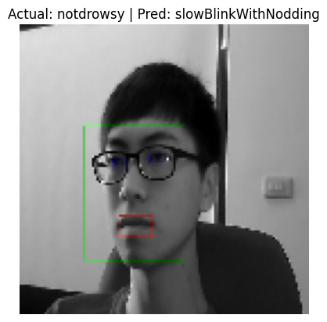
Test Predictions

Slide 13
Conclusion
The study implemented and evaluated multiple deep learning architectures, including a custom CNN and four transfer learning models, to classify driver drowsiness states under consistent experimental conditions.
Transfer learning models (MobileNetV2, VGG16, ResNet50, DenseNet201) demonstrated improved feature extraction capabilities compared to the custom CNN, due to pretrained ImageNet weights.
Among all models, lightweight architectures such as MobileNetV2 provided a strong balance between accuracy and computational efficiency, making them more suitable for real-time drowsiness detection systems.
Overall, the results indicate that deep learning-based approaches are effective for driver drowsiness detection, with performance strongly influenced by architecture choice, fine-tuning strategy, and regularization techniques.

Slide 14
Future Work
Improve model performance using larger and more diverse datasets
Implement real-time deployment in vehicles for live drowsiness detection
Optimize models for edge devices such as Raspberry Pi or mobile systems
Integrate additional sensors (e.g., steering patterns, heartbeat) for multi-modal detection
Enhance system robustness under different lighting and environmental conditions
Deploy the system as a driver assistance application for real-world use

Slide 15
References
Dinges, D.F. and Mallis, M.M. (1998) Managing fatigue in transportation.
Sikander, G. and Anwar, S. (2019) ‘Driver fatigue detection systems: A review’, IEEE Transactions on Intelligent Transportation Systems.
LeCun, Y., Bengio, Y. and Hinton, G. (2015) ‘Deep learning’, Nature.
Simonyan, K. and Zisserman, A. (2014) ‘Very deep convolutional networks for large-scale image recognition’.
He, K. et al. (2016) ‘Deep residual learning for image recognition’.
Howard, A.G. et al. (2017) ‘MobileNets: Efficient convolutional neural networks’.
Dunn, J. et al. (2020) Challenges in real-time driver monitoring systems.

Slide 16
Thank You

